Slide 1

Analysis on Data Science Salaries (2020-2023)

Slide 2
CONTENTS OF THIS TEMPLATE

Slide 3
TABLE OF CONTENTS

Slide 4
Introduction
Data science salaries are rapidly evolving.
Understanding the factors that influence data science salaries is essential for both professionals and organizations.
This project analyzes a comprehensive dataset of data science salaries from 2020 to 2023 to provide insights into the factors that drive compensation, such as experience, location, and industry.
The findings of this analysis can help professionals make informed decisions about their careers and organizations develop competitive compensation strategies.

Slide 5
Dataset Overview
The dataset provides valuable insights into the trends and fluctuations in data science compensation.
It offers a wide range of salary information across diverse industries, organizations, and geographic regions.
It can be used to analyze salary patterns in the data science field during the 2020-2023 timeframe.
It is a valuable resource for gaining a deeper understanding of the prevailing salary landscape.
It can help professionals and organizations make informed decisions regarding compensation strategies and career choices.

Slide 6
Attributes:
Job Title
Employment Type
Experience Level
Expertise Level
Salary
Salary Currency
Company Location
Salary in USD
Employee Residence
Company Size
Year

Slide 7
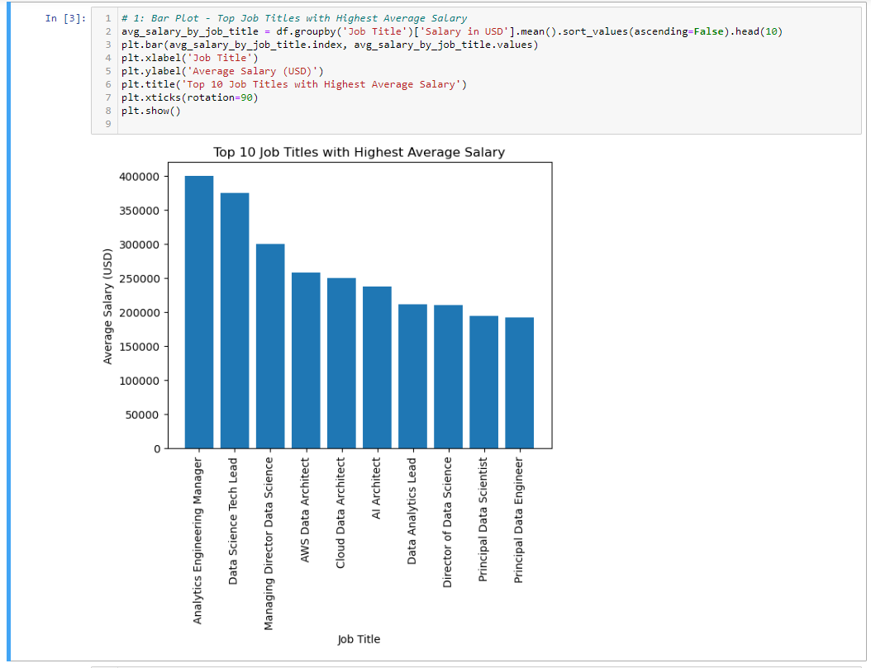
Data Visualization in Jupyter
Top Job Titles with Highest Average Salary

Slide 8
The image shows a bar graph with the top 10 job titles with the highest average salary.
The titles are arranged in ascending order, with the highest salary at the top and the lowest salary at the bottom.
The average salary for the top 10 job titles ranges from $400,000 to $230,000.
The job titles with the highest average salaries are Chief Executive Officer (CEO), Medical Professionals, Corporate Lawyer, Investment Banker, and Data Scientist.

Slide 9
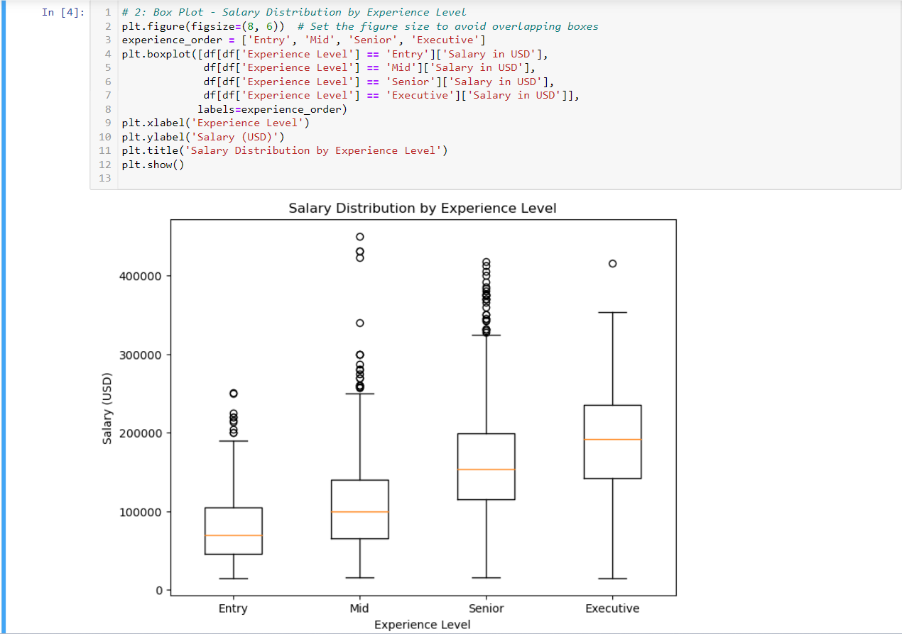
Salary Distribution by Experience Level

Slide 10
The image shows a box plot of salary distribution by experience level.
The box plot shows the distribution of salaries for four experience levels: Entry, Mid, Senior, and Executive.
The salaries are shown in USD.
The median salary increases with experience level.
The interquartile range (IQR) is smallest for the Entry level and largest for the Executive level.
There are a few outliers for the Executive level, with salaries above $500,000.

Slide 11
Hypothesis:
Average Salary based on Experience level separated by year.
Average Salary of all Expertise levels for each Currency grouped by Employment Type.
Average Salary of Company location from highest to lowest.
21-30
31-50

Slide 12
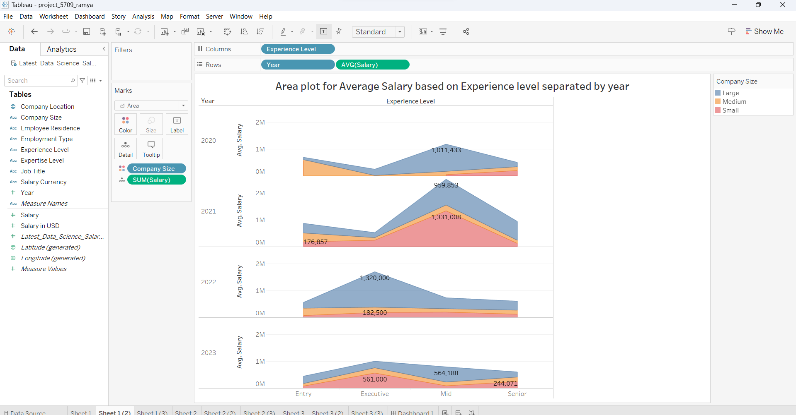

Slide 13
The image shows an area chart of average salary levels of experienced employees over time.
The chart is divided into four experience levels: Entry, Mid, Senior, and Executive.
The average salary for each experience level has increased over time.
The largest increase in average salary is for the Executive level.
The average salary for the Entry level has increased by the smallest amount.
The chart shows that the average salary for experienced employees is projected to continue to increase in the future.

Slide 14
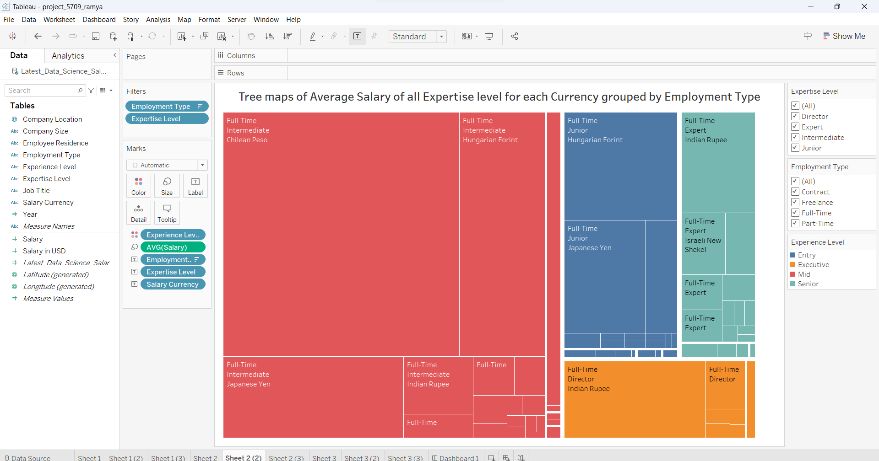

Slide 15
The image shows a tree map of average salary for all expertise levels for each currency grouped by employer type.
The tree map is divided into four sections: Employer Type, Currency, Expertise Level, and Average Salary.
The average salary is shown in USD.
The largest average salary is for employees who work for Private Companies in USD.
The smallest average salary is for employees who work for Government Agencies in EUR.
The tree map shows that the average salary varies depending on employer type, currency, and expertise level.

Slide 16
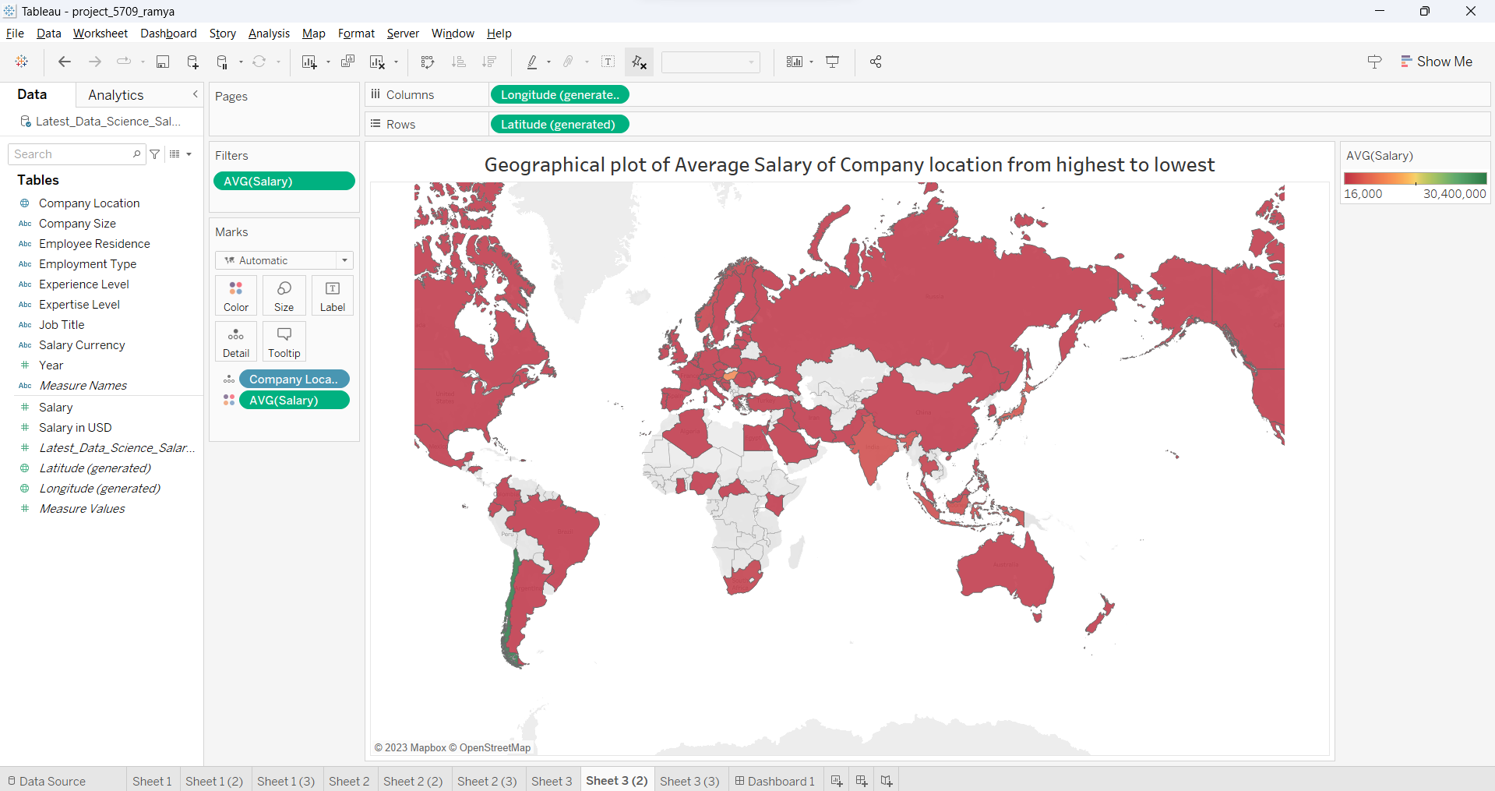

Slide 17
The image shows a map of the world with a red color scheme.
The red color scheme is used to represent the average salary of company locations from highest to lowest.
The countries with the highest average salaries are Switzerland, Singapore, and the United States.
The countries with the lowest average salaries are India, Bangladesh, and Nigeria.
The image shows that there is a significant difference in average salary between countries.
The image can be used to compare average salaries between countries and to identify countries with high-paying jobs.

Slide 18
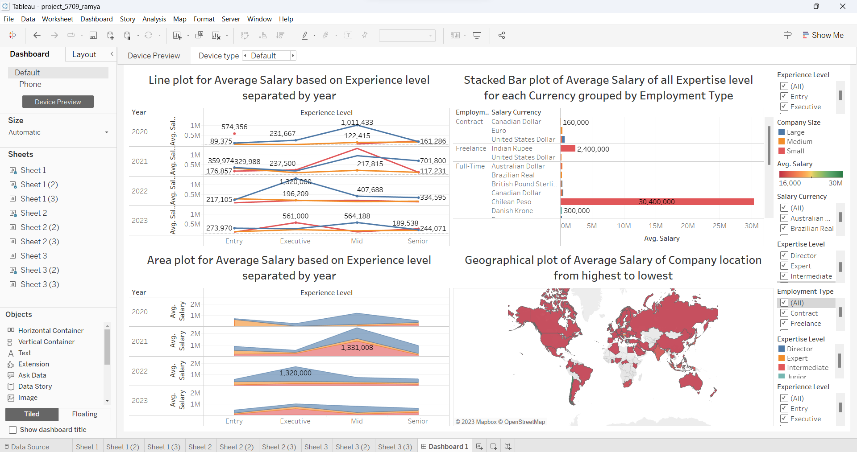
Dashboard

Slide 19
The image shows a spreadsheet with charts and graphs on a computer screen.
The charts and graphs show the average salary of all employees based on experience level, currency, employment type, and company location.
The data is from 2023 and shows that the average salary has increased for all experience levels over the past year.
The highest average salary is for employees with 10+ years of experience in the United States.
The image also shows that the average salary for employees in the tech industry is significantly higher than the average salary for employees in other industries.
The image is a useful tool for understanding salary trends and for comparing salaries between different industries and experience levels.

Slide 20
Conclusion:

